Slide 1
Round Complexity of Common Randomness Generation: The Amortized Setting
Noah Golowich Madhu Sudan
MIT
Harvard University

Slide 2










Common Randomness Generation (CRG)
Given source distribution $μ$ & iid samples $\left(X_{i}, Y_{i}\right)∼μ, { X}_{i}, Y_{i}∈{\left\{0,1\right\}}^{∗}.$
$r$rounds of communication via messages $Π_{1},Π_{2},…, Π_{r}∈{\left\{0,1\right\}}^{∗}:$
Goal: output keys $K_{A}, K_{B}∈{\left\{0,1\right\}}^{∗}$ of Alice, Bob satisfy:
  $K_{A}=K_{B}$ with high probability.
  $K_{A}, K_{B}$ have large entropy.
$$Π_{1}=Π_{1}(X_{1},X_{2},…)$$
$$Π_{2}=Π_{2}(Π_{1},Y_{1},Y_{2},…)$$
$$X_{1},X_{2},X_{3},…$$
Alice
$$Π_{3}=Π_{3}(Π_{1},Π_{2},X_{1},…)$$
Bob
$$Y_{1},Y_{2},Y_{3},…$$
$$Π_{4}=Π_{4}(Π,Π_{2},Π_{3},Y_{1},…)$$
$$…$$
$$K_{A}=K_{A}(Π_{1},Π_{2},…, X_{1},X_{2},…)$$
$$K_{B}=K_{B}(Π_{1},Π_{2},…, Y_{1},Y_{2},…)$$

Slide 3
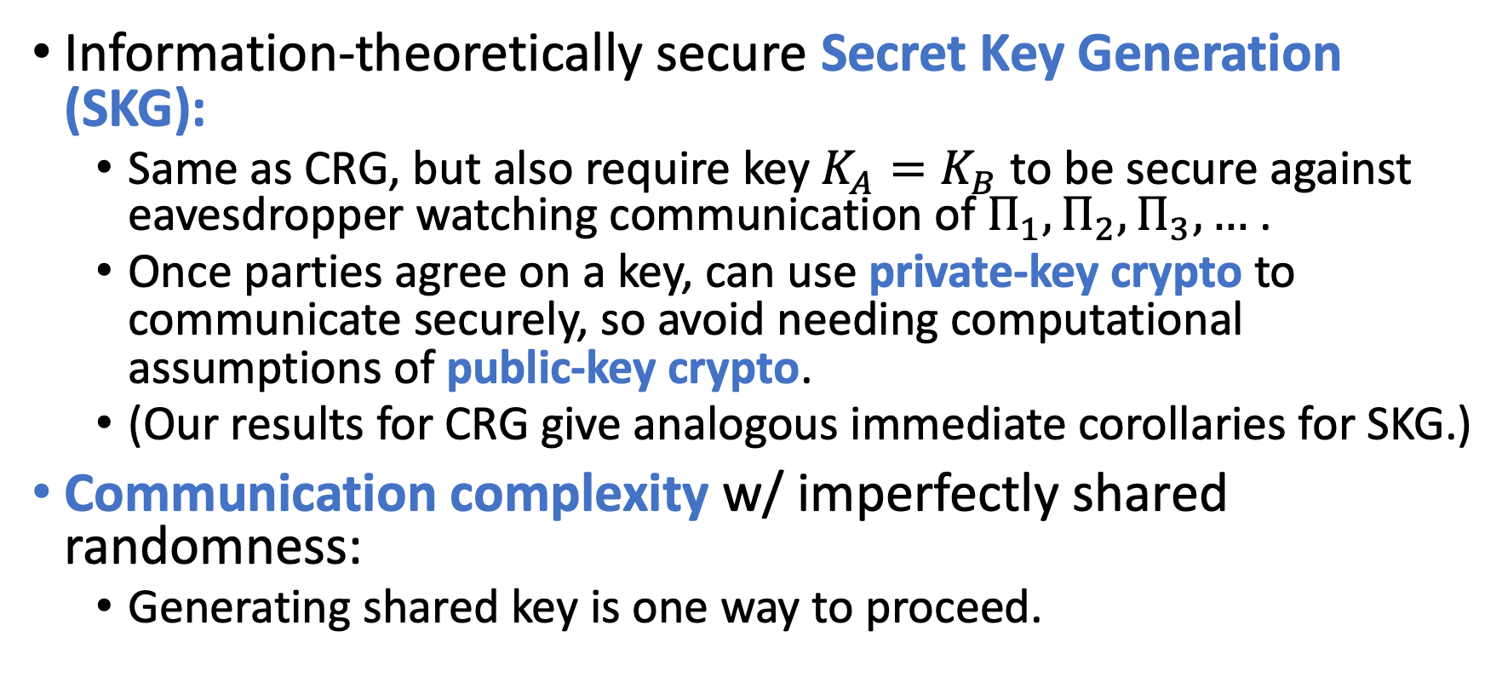
Motivation for CRG
Information-theoretically secure Secret Key Generation (SKG):
  Same as CRG, but also require key $K_{A}=K_{B}$ to be secure against eavesdropper watching communication of $Π_{1},Π_{2},Π_{3},…$ .
  Once parties agree on a key, can use private-key crypto to communicate securely, so avoid needing computational assumptions of public-key crypto.
  (Our results for CRG give analogous immediate corollaries for SKG.)
Communication complexity w/ imperfectly shared randomness:
  Generating shared key is one way to proceed.

Slide 4
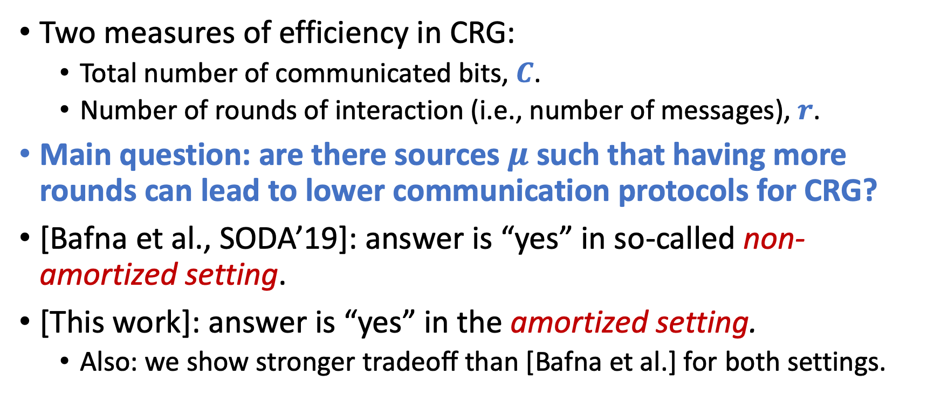
Round separations in CRG
Two measures of efficiency in CRG:
  Total number of communicated bits, $C$.
  Number of rounds of interaction (i.e., number of messages), $r$.
Main question: are there sources $μ$ such that having more rounds can lead to lower communication protocols for CRG?
[Bafna et al., SODA’19]: answer is “yes” in so-called non-amortized setting.
[This work]: answer is “yes” in the amortized setting.
  Also: we show stronger tradeoff than [Bafna et al.] for both settings.

Slide 5
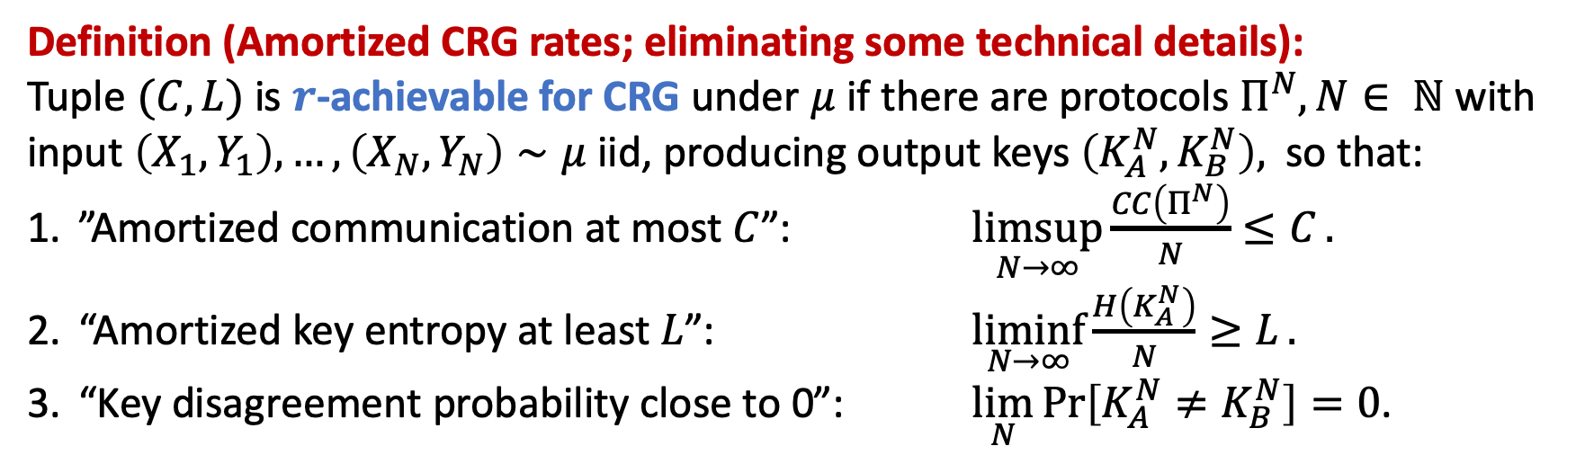
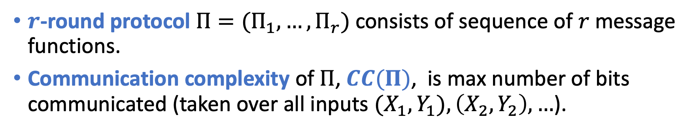
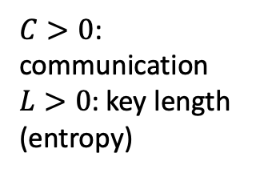
Amortized setting of CRG
$r$-round protocol $Π=(Π_{1},…, Π_{r})$ consists of sequence of $r$ message functions.
Communication complexity of $Π$, $CC(Π)$, is max number of bits communicated (taken over all inputs ${(X}_{1}, Y_{1}), \left(X_{2},Y_{2}\right),…$).
$C>0$: communication
$L>0$: key length (entropy)
Definition (Amortized CRG rates; eliminating some technical details):
Tuple $(C, L)$ is $r$-achievable for CRG under $μ$ if there are protocols $Π^{N}, N∈ ℕ$ with input $\left(X_{1},Y_{1}\right), …, \left(X_{N}, Y_{N}\right)∼μ$ iid, producing output keys $\left(K_{A}^{N},K_{B}^{N}\right),$ so that:
”Amortized communication at most $C$”: $\underset{N→∞}{limsup}{\frac{CC\left(Π^{N}\right)}{N}≤C}.$
“Amortized key entropy at least $L$”: $\underset{N→∞}{liminf}{\frac{H\left(K_{A}^{N}\right)}{N}≥L}.$
“Key disagreement probability close to 0”: $\lim_{N}{\operatorname{Pr}\left[K_{A}^{N}≠K_{B}^{N}\right]=0}$.

Slide 6


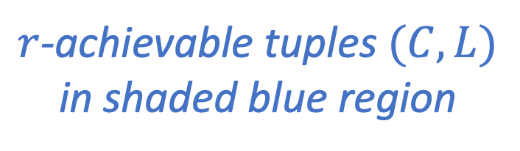
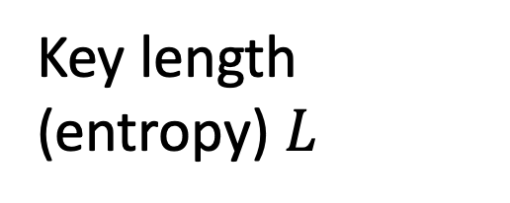
Representative shape of $r$-achievable region for some $μ$
Key length (entropy) $L$
…
$r$-achievable tuples $(C,L)$ in shaded blue region
Communication $C$

Slide 7
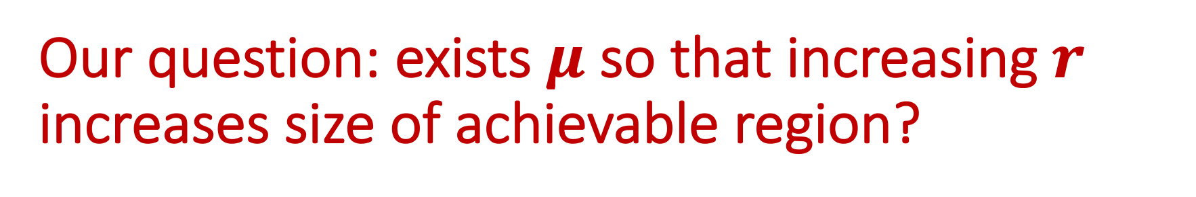
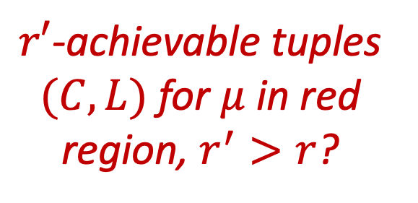
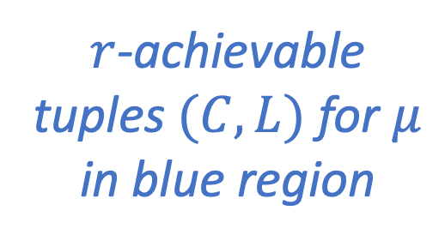
Our question: exists $μ$ so that increasing $r$ increases size of achievable region?
$r′$-achievable tuples $(C,L)$ for $μ$ in red region, $r^{′}>r$?
Key length (entropy) $L$
…
$r$-achievable tuples $(C,L)$ for $μ$ in blue region
Communication $C$

Slide 8
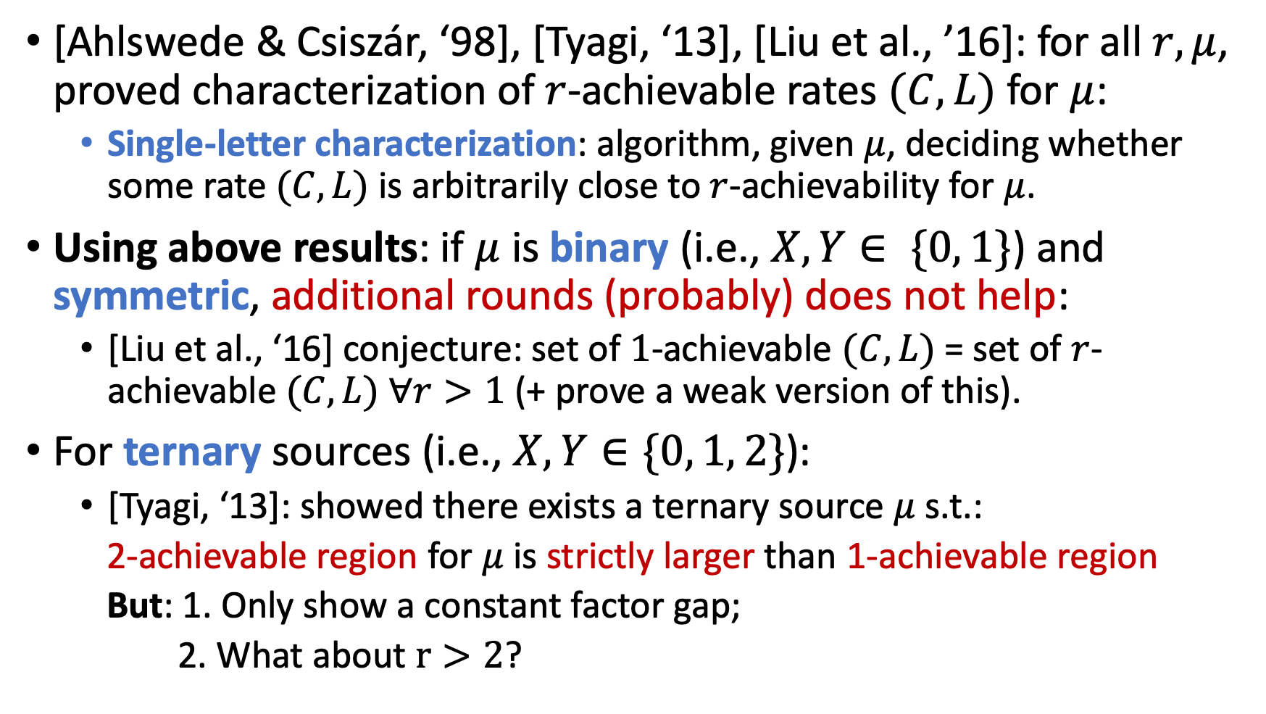
Prior work: rounds-communication tradeoffs
[Ahlswede & Csiszár, ‘98], [Tyagi, ‘13], [Liu et al., ’16]: for all $r,μ$, proved characterization of $r$-achievable rates $(C,L)$ for $μ$:
  Single-letter characterization: algorithm, given $μ$, deciding whether some rate $(C,L)$ is arbitrarily close to $r$-achievability for $μ$.
Using above results: if $μ$ is binary (i.e., $X, Y∈ \{0, 1\}$) and symmetric, additional rounds (probably) does not help:
  [Liu et al., ‘16] conjecture: set of $1$-achievable $(C,L)$ = set of $r$-achievable $(C, L)$ $∀r>1$ (+ prove a weak version of this).
For ternary sources (i.e., $X, Y∈\{0, 1, 2\}$):
  [Tyagi, ‘13]: showed there exists a ternary source $μ$ s.t.:
  2-achievable region for $μ$ is strictly larger than 1-achievable region
  But: 1. Only show a constant factor gap;
  2. What about $r>2$?

Slide 9

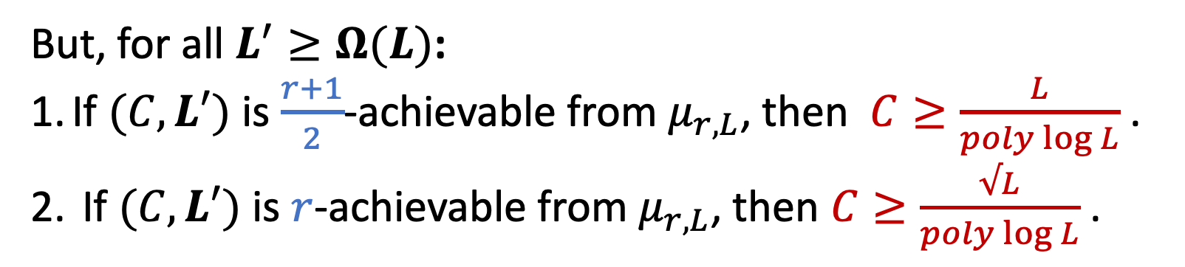
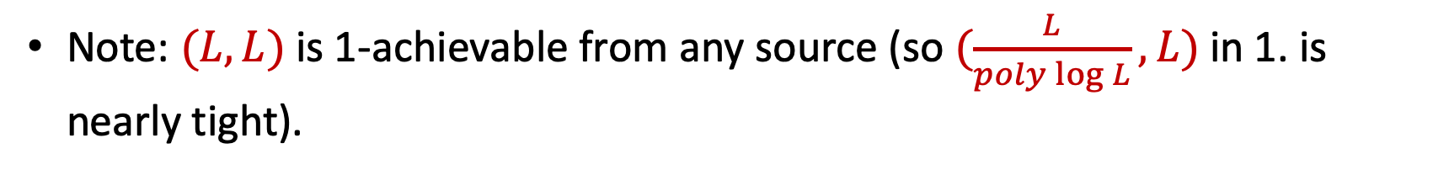

Our theorem: exponential rounds-communication tradeoffs for all $r$
Theorem [This work]:
For all $r∈ℕ$, $L>0$, there is a source $μ_{r,L}$ so that:
$∃C≤O(\log{L)}$ s.t. $(C, L)$ is $(r+2)$-achievable from $μ_{r,L};$
But:
If $(C, L)$ is $\frac{r+1}{2}$-achievable from $μ_{r,L}$, then $C≥\frac{L}{poly\log{L}}$ .
If $(C, L)$ is $r$-achievable from $μ_{r,L}$, then $C≥\frac{√L}{poly\log{L}}$.
But, for all $L^{′}≥Ω(L)$:
If $(C, L′)$ is $\frac{r+1}{2}$-achievable from $μ_{r,L}$, then $C≥\frac{L}{poly\log{L}}$ .
If $(C, L′)$ is $r$-achievable from $μ_{r,L}$, then $C≥\frac{√L}{poly\log{L}}$ .
Note: $(L,L)$ is 1-achievable from any source (so $(\frac{L}{poly\log{L}}, L)$ in 1. is nearly tight).

Slide 10

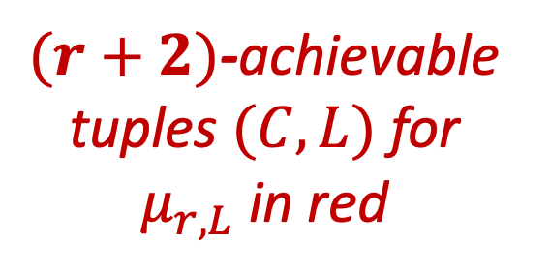

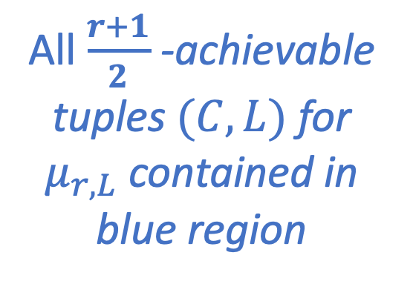
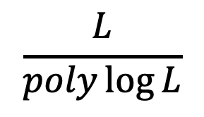


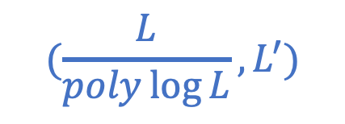
Our results visualized
$(r+2)$-achievable tuples $(C,L)$ for $μ_{r,L}$ in red
$$L$$
$$(O(\log{L),L)}$$
Key length (entropy)
…
$$(\frac{L}{poly\log{L}}, L^{′})$$
All $\frac{r+1}{2}$ -achievable tuples $(C,L)$ for $μ_{r,L}$ contained in blue region
$$L^{′}=Θ(L)$$
$$\log{L}$$
$$\frac{L}{poly\log{L}}$$
Communication

Slide 11
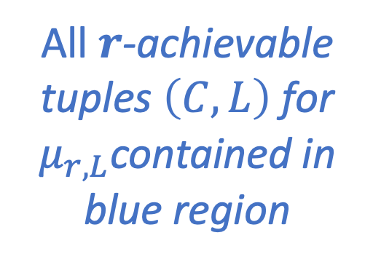
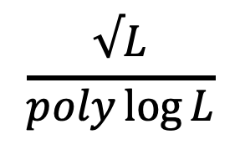
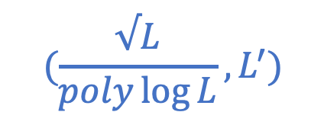
Our results visualized
$(r+2)$-achievable tuples $(C,L)$ for $μ_{r,L}$ in red
$$L$$
$$(O(\log{L),L)}$$
Key length (entropy)
…
$$(\frac{√L}{poly\log{L}}, L^{′})$$
All $r$-achievable tuples $\left(C,L\right)$ for $μ_{r,L}$contained in blue region
$$L^{′}=Θ(L)$$
$$\log{L}$$
$$\frac{√L}{poly\log{L}}$$
Communication

Slide 12
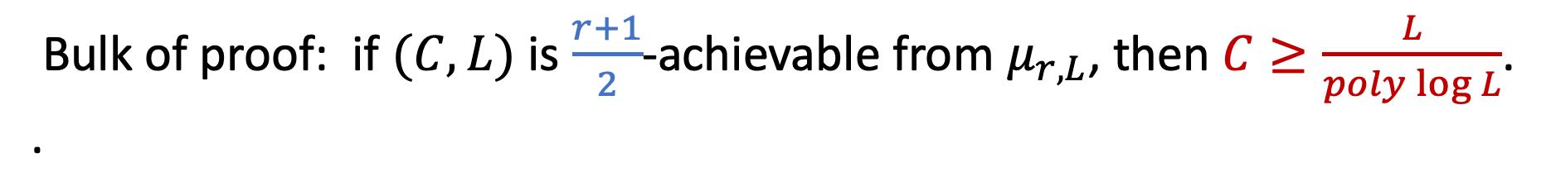
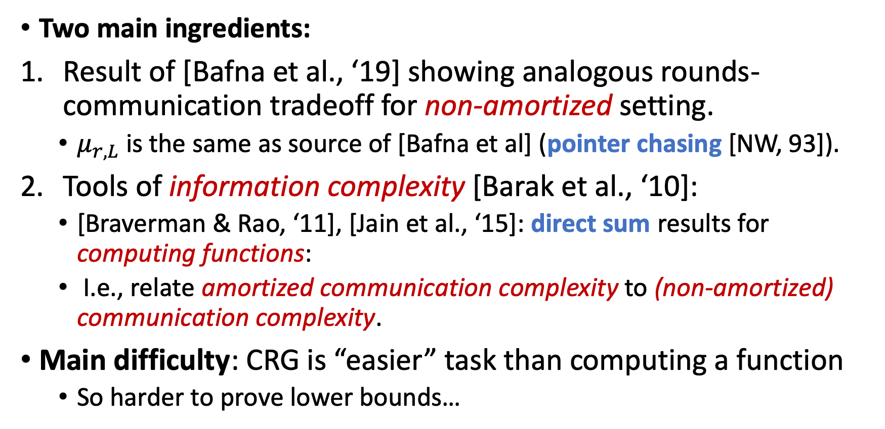
Proof idea of main theorem
Bulk of proof: if $(C, L)$ is $\frac{r+1}{2}$-achievable from $μ_{r,L}$, then $C≥\frac{L}{poly\log{L}}$. .
Two main ingredients:
Result of [Bafna et al., ‘19] showing analogous rounds-communication tradeoff for non-amortized setting.
  $μ_{r,L}$ is the same as source of [Bafna et al] (pointer chasing [NW, 93]).
Tools of information complexity [Barak et al., ‘10]:
  [Braverman & Rao, ‘11], [Jain et al., ‘15]: direct sum results for computing functions:
  I.e., relate amortized communication complexity to (non-amortized) communication complexity.
Main difficulty: CRG is “easier” task than computing a function
  So harder to prove lower bounds…

Slide 13
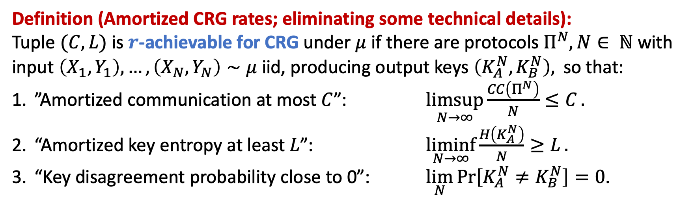
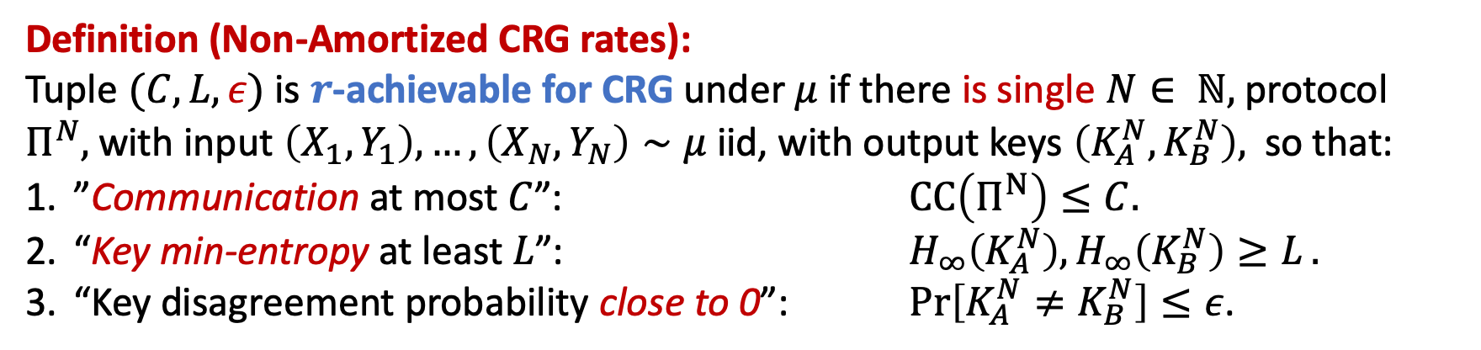
Quick detour: amortized vs. non-amortized CRG
Definition (Amortized CRG rates; eliminating some technical details):
Tuple $(C, L)$ is $r$-achievable for CRG under $μ$ if there are protocols $Π^{N}, N∈ ℕ$ with input $\left(X_{1},Y_{1}\right), …, \left(X_{N}, Y_{N}\right)∼μ$ iid, producing output keys $\left(K_{A}^{N},K_{B}^{N}\right),$ so that:
”Amortized communication at most $C$”: $\underset{N→∞}{limsup}{\frac{CC\left(Π^{N}\right)}{N}≤C}.$
“Amortized key entropy at least $L$”: $\underset{N→∞}{liminf}{\frac{H\left(K_{A}^{N}\right)}{N}≥L}.$
“Key disagreement probability close to 0”: $\lim_{N}{\operatorname{Pr}\left[K_{A}^{N}≠K_{B}^{N}\right]=0}$.
Definition (Non-Amortized CRG rates):
Tuple $(C, L, ε)$ is $r$-achievable for CRG under $μ$ if there is single $N∈ ℕ,$ protocol $Π^{N},$with input $\left(X_{1},Y_{1}\right), …, \left(X_{N}, Y_{N}\right)∼μ$ iid, with output keys $\left(K_{A}^{N},K_{B}^{N}\right),$ so that:
”Communication at most $C$”: $CC\left(Π^{N}\right)≤C.$
“Key min-entropy at least $L$”: $H_{∞}\left(K_{A}^{N}\right), H_{∞}\left(K_{B}^{N}\right){≥L}.$
“Key disagreement probability close to 0”: $\operatorname{Pr}\left[K_{A}^{N}≠K_{B}^{N}\right]≤ε$.

Slide 14
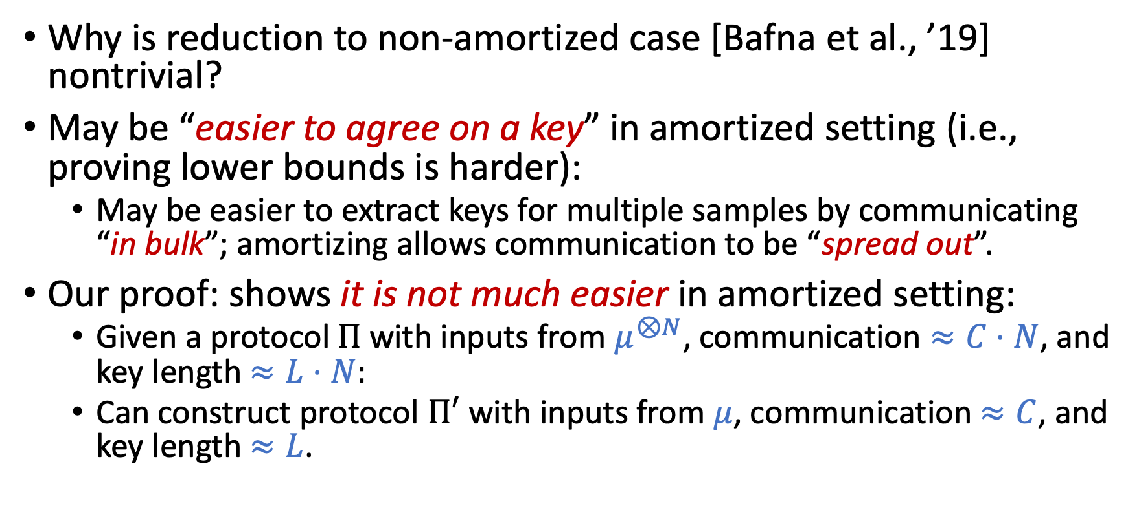
Lower bound proof: amortized vs non-amortized
Why is reduction to non-amortized case [Bafna et al., ’19] nontrivial?
May be “easier to agree on a key” in amortized setting (i.e., proving lower bounds is harder):
  May be easier to extract keys for multiple samples by communicating “in bulk”; amortizing allows communication to be “spread out”.
Our proof: shows it is not much easier in amortized setting:
  Given a protocol $Π$ with inputs from $μ^{⊗N}$, communication $≈C⋅N$, and key length $≈L⋅N:$
  Can construct protocol $Π′$ with inputs from $μ$, communication $≈C$, and key length $≈L$.

Slide 15

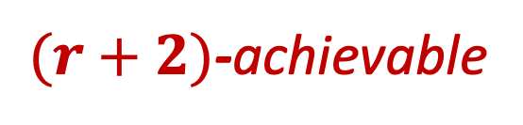
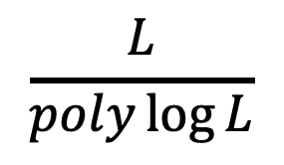
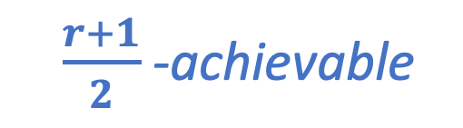



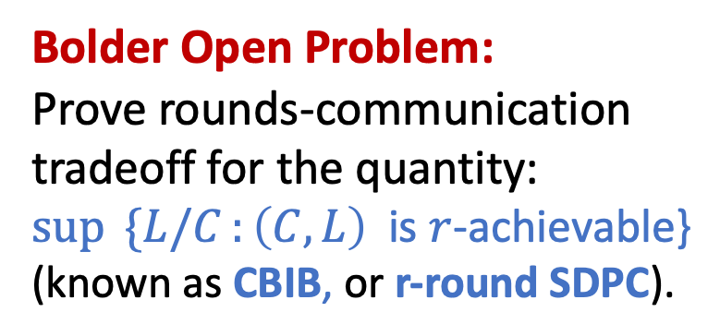
Conclusion / Open Problem
Open Problem:
Can we relax the requirement that $L^{′}=Θ(L)$? I.e., “move the blue line down”?
Formally: show that $\left(C, L^{′}\right)$ is not $\frac{r+1}{2}$ -achievable for some $L^{′}≪Θ(L)$, $C<\frac{L}{poly\log{L}}.$
Our main separation for CRG:
$$L$$
$(r+2)$-achievable
$$L^{′}= Θ(L)$$
Bolder Open Problem:
Prove rounds-communication tradeoff for the quantity:
$\sup{ \{L/C}:\left(C, L\right) ⁡$is $r$-achievable}
(known as CBIB, or r-round SDPC).
$\frac{r+1}{2}$ -achievable
$$\log{L}$$
$$\frac{L}{poly\log{L}}$$
Communication

Slide 16
Thank you!
I am grateful to the NSF for providing a student travel grant.

Slide 17
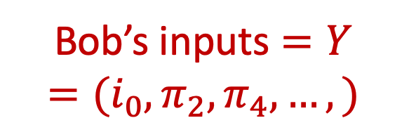
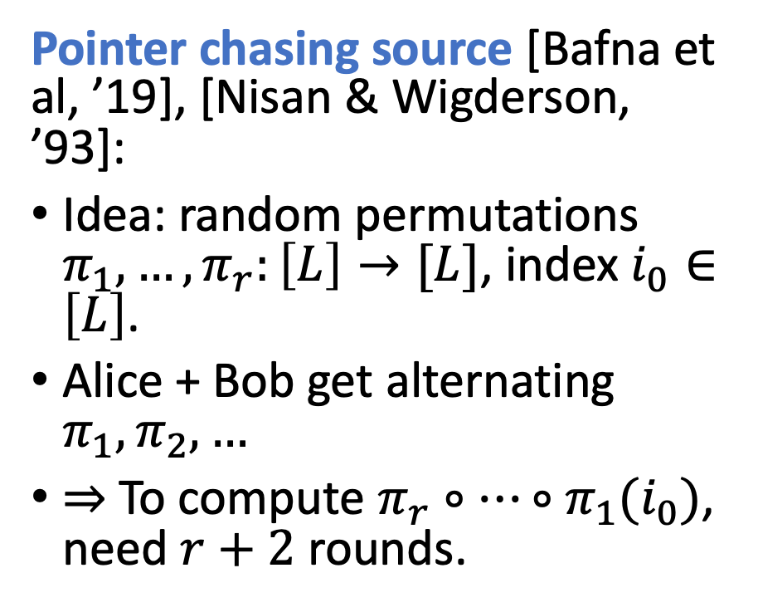
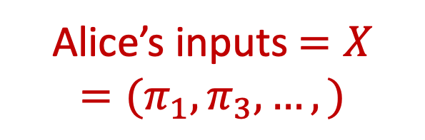





What is the source $μ_{r,L}$in main theorem?
$$i_{0}$$
Pointer chasing source [Bafna et al, ’19], [Nisan & Wigderson, ’93]:
Idea: random permutations $π_{1},…, π_{r}:\left[L\right]→[L]$, index $i_{0}∈\left[L\right]$.
Alice + Bob get alternating $π_{1},π_{2},…$
$⇒$ To compute $π_{r}∘⋯∘π_{1}(i_{0})$, need $r+2$ rounds.
$$π_{1}$$
$$π_{1}$$
…
$π_{r}∘⋯∘π_{1}(i_{0})$
Hidden block of shared randomness
…
…
Alice’s inputs $=X$
$$=(π_{1},π_{3},…, )$$
Bob’s inputs $=Y$
$$=(i_{0},π_{2},π_{4},…, )$$

Slide 18
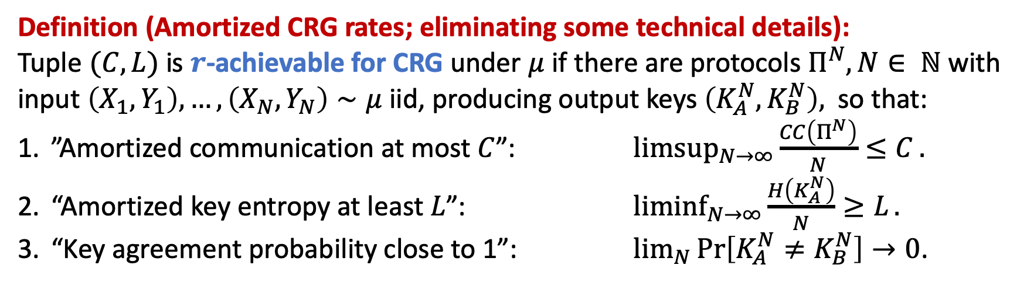
Quick detour: amortized vs non-amortized CRG
Definition (Amortized CRG rates; eliminating some technical details):
Tuple $(C, L)$ is $r$-achievable for CRG under $μ$ if there are protocols $Π^{N}, N∈ ℕ$ with input $\left(X_{1},Y_{1}\right), …, \left(X_{N}, Y_{N}\right)∼μ$ iid, producing output keys $\left(K_{A}^{N},K_{B}^{N}\right),$ so that:
”Amortized communication at most $C$”: $\underset{N→∞}{limsup}{\frac{CC\left(Π^{N}\right)}{N}≤C}.$
“Amortized key entropy at least $L$”: $\underset{N→∞}{liminf}{\frac{H\left(K_{A}^{N}\right)}{N}≥L}.$
“Key agreement probability close to 1”: $\lim_{N}{\operatorname{Pr}\left[K_{A}^{N}≠K_{B}^{N}\right]→0}$.

